Slide 1
CS 5900 Compiler
Context-Free Grammar and Parsing
Note: There are many mistakes in this document

Slide 2
Chapter 3. Context-Free Grammar and Parsing Language: A set of strings (finite) of elements over an alphabet Σ. Note: 1) Strings are also known as words, sentences. 2) Elements in Σ are called terminals

Slide 3
Here is a context-free grammar:
expr expr – expr | num
num 0 | 1 | 2 | 3 | 4 | 5
Terminals Σ={0,1,2,3,4,5,-}
Nonterminals: expr, num
Sequence of tokens: 2 – 5 – 3 (5 tokens total)

Slide 4
two different trees for same expression: 2-5-3
*use bottom up evaluation
solution of -6
solution of 0
expr
expr
expr
expr
expr
-
expr
-
expr
expr
expr
expr
num
3
num
2
-
-
num
5
num
3
num
2
num
5

Slide 5
Derivation (left most derivation, select left-most non-terminal first)
expr => expr - expr
=> expr – expr – expr
=> num – expr – expr
=> 2 – expr – expr
=> 2 – num – expr
=> 2 – 5 – expr
=> 2 - 5 – num
=> 2 – 5 - 3
expr expr – expr | num
num 0 | 1 | 2 | 3 | 4 | 5

Slide 6
Derivation (another left-most derivation)
expr => expr - expr
num – expr
2 – expr
2 – expr – expr
2 – num – expr
2 – 5 – expr
2 - 5 – num
2 – 5 - 3
expr expr – expr | num
num 0 | 1 | 2 | 3 | 4 | 5

Slide 7
There exist two different left-most derivations and parse trees for the expression 2 - 5 - 3 with given the grammar rules.
This grammar is an ambiguous grammar.

Slide 8
Formal definition for context free grammar
A context free grammar is a quadruple (V, Σ, P, S) where,
V is a finite set of variables (non-terminal),
is the alphabet (terminals),
S is the start symbol (S ∈ V),
P is a finite set of rules (production rules).

Slide 9
Number of rules in a given grammar
expr expr – expr | num
num 0 | 1 | 2 | 3 | 4 | 5
This example has 8 rules:
expr expr – expr
expr num
num 0
num 1
num 2
num 3
num 4
num 5

Slide 10
Example 1
G = (V, Σ, P, S) V = {S, A} Σ = {a,b}
P: S AA, A AAA | bA | Ab | a
Show that ababaa is in the language G defines.
S => AA
AAAA
AbAAA
abAAA
abAbAA
ababAA
ababaA
ababaa

Slide 11
Example 1
S abScB | ɛ , B bB | b
This grammar has 4 production rules.
Always start from S.
S eventually goes to ɛ to terminate.
A few strings in the language, ɛ, abcb, abcbb

Slide 12

Example 2
L = {$a^{n} b^{n}$ | n > 0} n in an integer.
S aSb | ab
S => aSb
=>aabb
This grammar is context free but not regular.

Slide 13
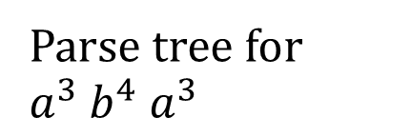
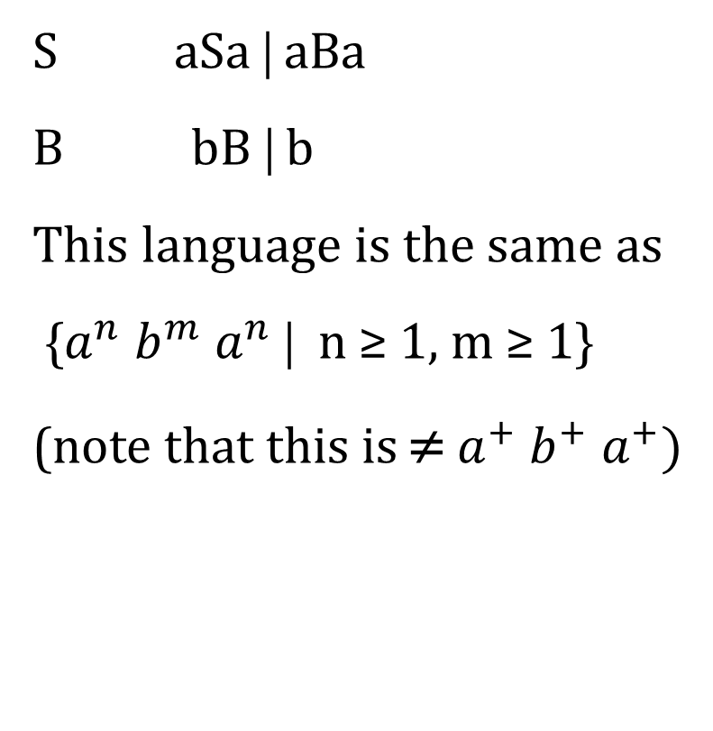
Example 3
S aSa | aBa
B bB | b
This language is the same as
{$a^{n} b^{m}{ a}^{n}$ | n ≥ 1, m ≥ 1}
(note that this is ≠ $a^{+} b^{+}{ a}^{+})$
S
Parse tree for $a^{3} b^{4}{ a}^{3}$
a
a
S
a
a
S
a
B
a
b
B
b
B
b
B
b

Slide 14
Example 4: Regular Express vs CFG
a*
A aA | ɛ
a⁺
A aA | a

Slide 15
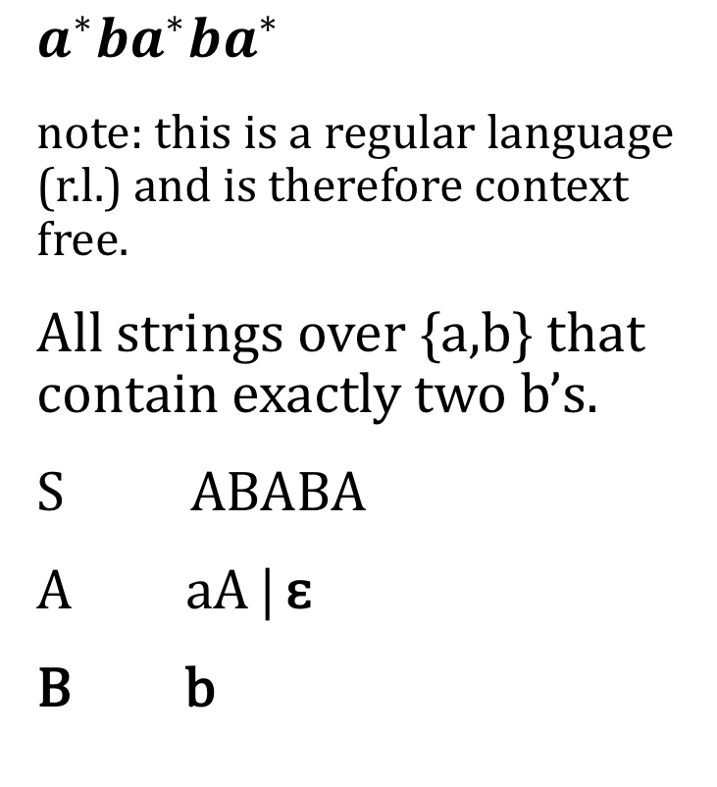
Example 4
$a^{∗}{ba}^{∗}{ba}^{∗}$
note: this is a regular language (r.l.) and is therefore context free.
All strings over {a,b} that contain exactly two b’s.
S ABABA
A aA | ɛ
B b
S
A
B
B
A
A
a
A
A
b
b
a
ɛ
ɛ
a
A
ɛ

Slide 16

Example 4, cont.
$a^{∗}{ba}^{∗}{ba}^{∗}$
now, without ɛ.
S AbAbA | bAbA | AbbA | AbAb | bbA | bAb | Abb | bb
A aA | a

Slide 17
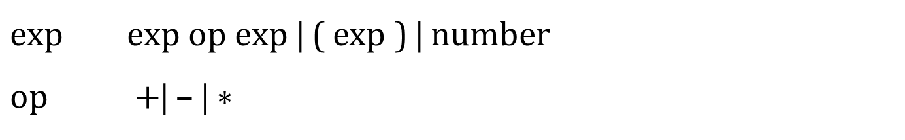
Example 5
$exp exp op exp$ | ( exp ) | number
$op +$| – | ∗
exp
Parse tree for:
((3+5) * (3 + 8)) * (5-1)
1
exp
op
exp
(
)
exp
(
)
2
1
3
exp
∗
exp
op
exp
op
exp
exp
(
exp
)
∗
2
(
)
–
exp
number
5
number
1
3
exp
op
exp
exp
op
exp
number
3
+
number
3
+
number
5
number
8

Slide 18
Example 7
statement if-stmt | other
if-stmt if ( exp ) statement
| if ( exp ) statement else statement
exp 0 | 1
terminals include: ( , ), if, other, else, 0, 1

Slide 19
Example 8
statement if-stmt | other
if-stmt if ( exp ) statement else-part
else-part else statement | ɛ
exp 0 | 1
Parse Tree:
Interior nodes are labeled by non-terminals; leaf nodes are labeled by terminals.

Slide 20
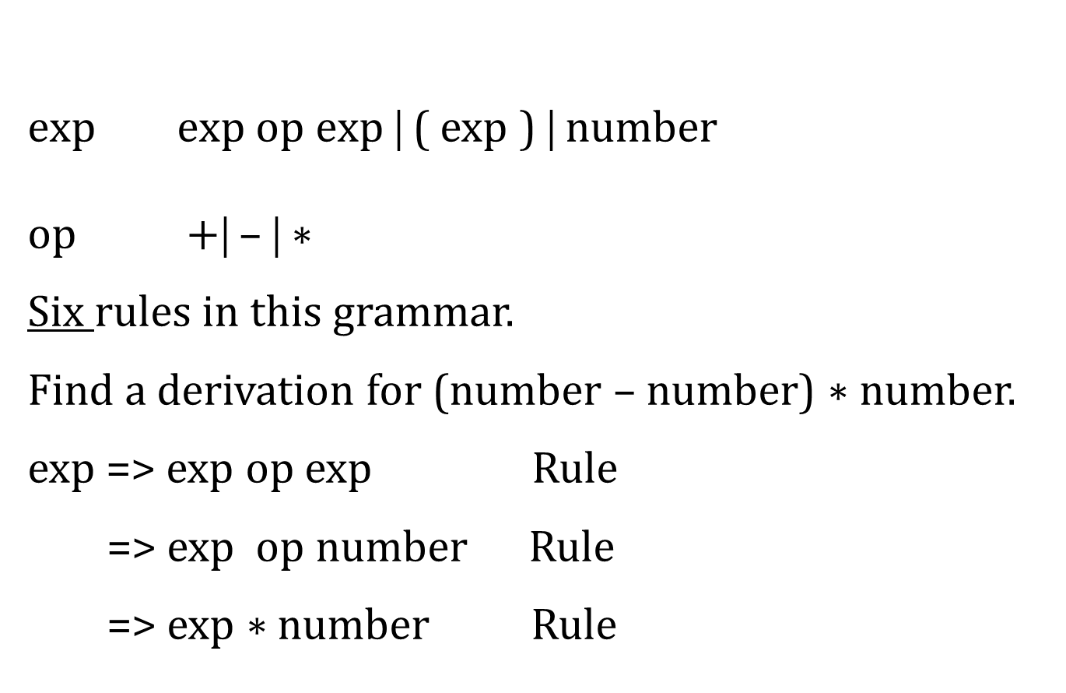
Example 1
$exp exp op exp$ | ( exp ) | number
$op +$| – | ∗
Six rules in this grammar.
Find a derivation for (number – number) ∗ number.
exp => exp op exp Rule
=> exp op number Rule
=> exp ∗ number Rule
1
2
3
4
5
6
1
3
6
⋯
⋯

Slide 21
Example (Parse Tree)
(34 - 3) ∗ 42
Tree traversal: Pick up a terminal (leaf) at first visit.
exp
exp
op
exp
*
(
exp
)
number
42
exp
op
exp
-
number
34
number
3

Slide 22
Example (Syntax Tree)
(34 - 3) ∗ 42
Syntax tree: Pick up a node (leaf or nonleaf) at second visit.
1
∗
2
1
42
-
1
2
2
3
1
2
34
2
1

Slide 23
Derivation recap
Left-most derivation: left most non-terminal is replaced at each step, first.
Right-most derivation: Replace the right most non-terminal first at each step.

Slide 24
Example 9 (Skip Post-order, pre-order, …)
Post-order numbering vs. Pre-order numbering
“2-5” post vs. pre 2 5 - vs. - 2 5
Post-order numbering
5 3 2 ∗ - 4 + = 5 6 – 4 +
= (-1) 4 +
= 3
2. Pre-order numbering rewritten,
+ - 5 ∗ 3 2 4 = + - 5 6 4
= + (-1) 4
= 3

Slide 25
Example 10 (Skip)
In-order numbering 5 – 3 – 2
result? 0 or 4
2. Consider post-order numbering
5 3 – 2 – = 0 and 5 3 2 – – = 4
3. Consider pre-order numbering
– – 5 3 2 = 0 and – 5 – 3 2 = 4
Need a way to get rid of ambiguity.
A context-free grammar rule in BNF uses the two mega symbols: | ONLY.

Slide 26
Ambiguity
Ambiguity: A context-free grammar, G, is ambiguous if there are two distinct parse trees for some word (string).
Note: We may consider: for one word (string)
2 parse trees
2 syntax trees
2 left-most derivations
2 right-most derivations
-Easier to show a grammar is ambiguous, just find an example string. It is harder to show that a grammar is not ambiguous.

Slide 27
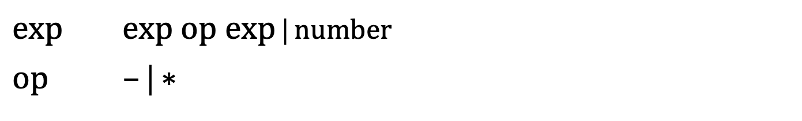
We will discuss the ambiguity of the grammar
Pay attention to the precedence and associativity.
$exp exp op exp$ | number
$op$ – | ∗

Slide 28
Example 11 (precedence not specified in the grammar)
1) 34 – 3 ∗ 42
Show ambiguity by generating two syntax trees.
–
∗
34
∗
-
42
3
42
34
3

Slide 29
Example 11 (Associativity not specified in grammar)
2 – 5 – 3
Show ambiguity by generating two syntax trees.
-
-
-
3
2
-
2
5
5
3

Slide 30
How to get rid of ambiguity
Solutions to getting rid of ambiguity:
State a disambiguation rule that specifies in each ambiguous case which parse trees (or syntax tree) is the correct one.
good: it does not change the grammar.
bad: the syntax structure is no longer given by the grammar alone.
2. Change the grammar into a form that forces the construction of the correct parse tree.

Slide 31
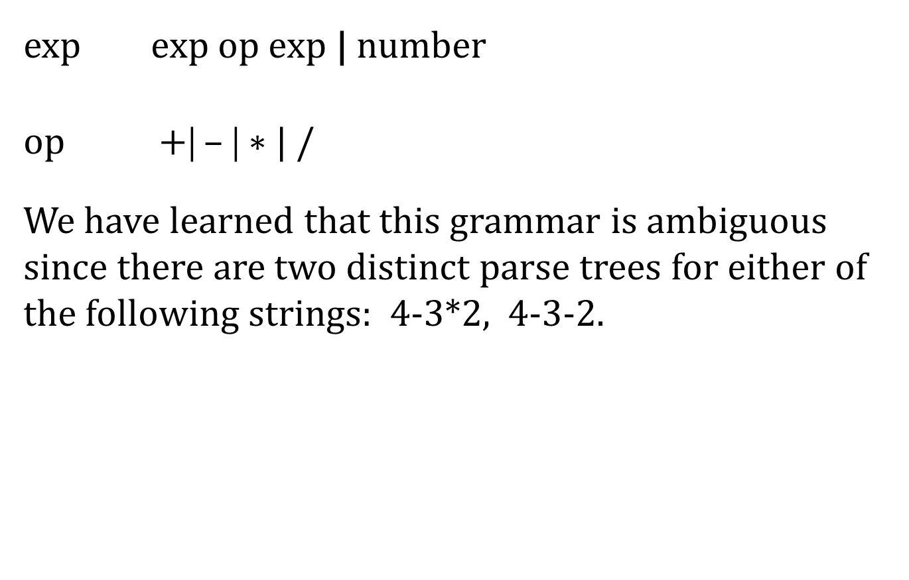
$exp exp op exp$ | number
$op +$| – | ∗ | /
We have learned that this grammar is ambiguous since there are two distinct parse trees for either of the following strings: 4-3*2, 4-3-2.

Slide 32
two different parse trees for same string: 4-3*2
*use bottom up evaluation
Solution: 2
Solution: -2
expr
expr
expr
expr
op
op
expr
expr
expr
expr
expr
expr
op
num
2
num
4
-
op
*
num
3
*
num
2
num
4
num
3
-

Slide 33
Change of Grammar
I. Precedence: +, - same precedence
∗, / a higher precedence
Try this new grammar:
exp exp addop exp | term
addop + | -
term term mulop term | number
mulop ∗ | /
(force subtraction first means higher in tree. Lower in tree means higher precedence.)

Slide 34
Change of Grammar example
Example: Try this new grammar on 4 – 3 ∗ 2 to get unique parse tree.
exp
exp
addop
exp
–
term
term
number
4
term
mulop
term
∗
number
2
number
3

Slide 35
But, we still need to try it on 4 – 3 – 2.
exp
exp
addop
exp
–
exp
addop
exp
term
exp
term
–
term
number
2
exp
addop
exp
number
4
number
3
–
term
exp
addop
exp
Oops! Still ambiguous!
Two trees again.
–
number
4
term
term
number
3
number
2

Slide 36
Left -Associative
II. Left Associative (We use left recursion only.)
Try this new Grammar:
exp exp addop term | term
addop + | -
term term mulop factor | factor
mulop ∗ | /
factor number

Slide 37
Left -Associative
Now, try 4 – 3 – 2.
(Unique choice, only 1 way)
exp
exp
addop
term
factor
exp
addop
term
–
term
–
factor
number
2
factor
number
3
number
4

Slide 38
Ha ha!
Here is a more “complete” grammar for arithmetic:
exp exp addop term | term
addop + | –
term term mulop factor | factor
mulop ∗ | /
factor ( exp ) | number
Now we can handle addition, subtraction, multiplication, division, and parenthesis.

Slide 39
Example 12
exp
term
(34 – 3 ) ∗ 42
term
factor
mulop
factor
∗
number
42
(
exp
)
exp
addop
term
factor
term
–
factor
number
3
number
34

Slide 40
EBNF and BNF
EBNF - extended BNF
BNF uses two symbols: |
EBNF uses six symbols: | { } [ ]
Example 1:
BNF A Aa | b
language – All strings of {a,b} which start with b followed by any number of a’s. Simply-- ba*
EBNF: A b { a }

Slide 41
EBNF and BNF
Example 2
BNF: if-stmt if (exp) statement else-part
else-part else statement | ɛ
EBNF: if-stmt if (exp) statement [else statement]

Slide 42
Chapter 4. Top-Down Parsing
A top-down parsing algorithm parses an input string of tokens by tracing out the steps in a left-most derivation.
Two different forms of top down parsing:
Backtracking parsers – to try different possibilities
Predictive parsers – to attempt to predict the next construction, using one or more look-ahead tokens.
We will study recursive-descent parsing and LL(1) parsing.
L: process input from left to right
L: left-most derivation
1: one symbol to predict the direction of parse (look ahead 1)

Slide 43
Top Down Parsing by Recursive-descent
Basic Method
procedure factor;
begin
case token of
(: match ( ( );
exp;
match( ) );
number:
match (number);
else error;
end case;
end factor;
exp exp addop term | term
addop + | –
term term mulop factor | factor
mulop ∗
factor ( exp ) | number
Refer to pg. 144 of text

Slide 44
Repetition and Choice (using EBNF)
I.
A Aα | β left-recursive, α, β are a string of symbols.
EBNF: A β { α }
notes: Must have β to stop recursion.
A=> β or
A => Aα
=> A α α
=> β α α

Slide 45
Repetition and Choice (using EBNF)
II.
A αA | β Right-recursive
EBNF: A { α }β
III.
if-stmt if (exp ) statement
| if (exp ) statement else statement
EBNF: if-stmt if ( exp ) statement [ else statement ]

Slide 46
Repetition and Choice (using EBNF)
IV.
exp exp addop term | term (exp on right makes left-recursive)
Like previous example Aα, where α≡ addop term,
A ≡ exp, β ≡ term
EBNF: exp term { addop term }
This does not allow for choice so,
exp term [ addop term ]
is a better solution.

Slide 47
Repetition and Choice (using EBNF)
V.
stmt-seq stmt ; stmt-seq | stmt (right recursive)
EBNF: stmt-seq [ stmt ; stmt-seq ]; stmt
This does not stop like IV.

Slide 48

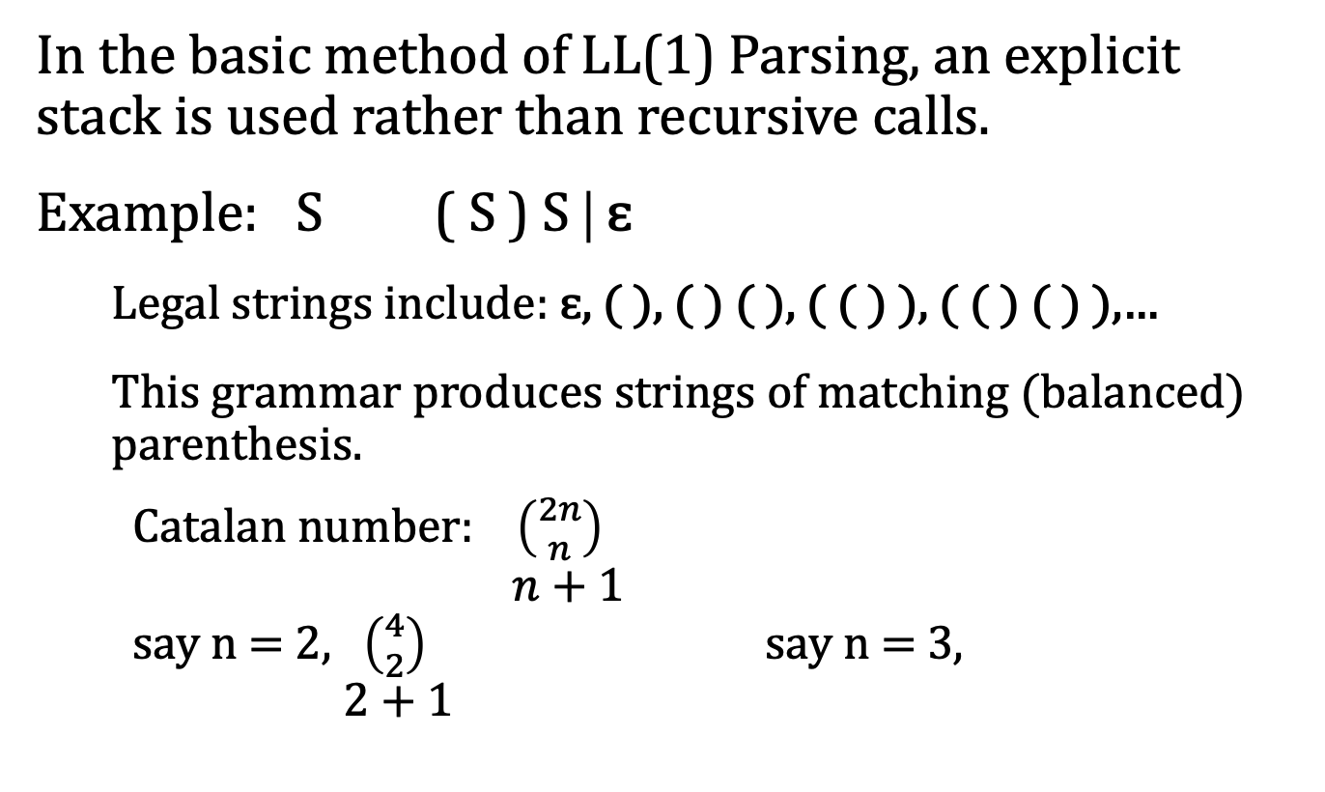


LL(1) Parsing
In the basic method of LL(1) Parsing, an explicit stack is used rather than recursive calls.
Example: S ( S ) S | ɛ
Legal strings include: ɛ, ( ), ( ) ( ), ( ( ) ), ( ( ) ( ) ),…
This grammar produces strings of matching (balanced) parenthesis.
Catalan number: $\left({2n \atop n}\right)$
$n$ + 1
say n = 2, $\left({4 \atop 2}\right)$ say n = 3,
$2$ + 1
$= \frac{6}{3}$ = 2
$\left({6 \atop 3}\right)$
$$4$$
$$=5$$
What is n = 4???

Slide 49
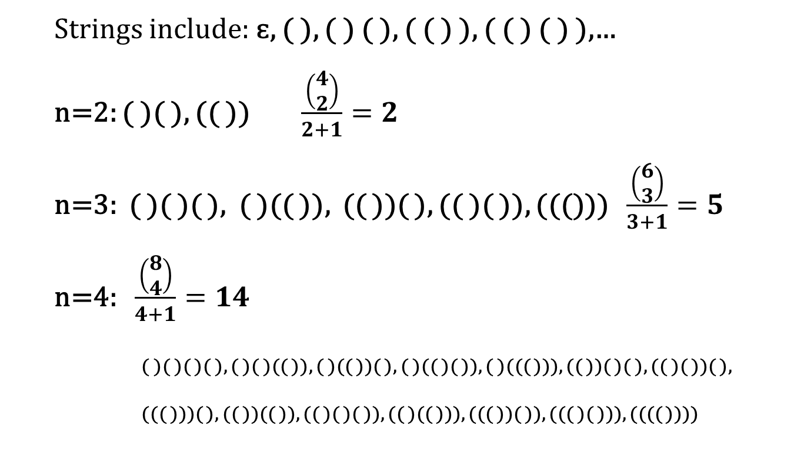
Strings include: ɛ, ( ), ( ) ( ), ( ( ) ), ( ( ) ( ) ),…
n=2: ( )( ), (( )) $\frac{\left(\begin{matrix}4 \\ 2\end{matrix}\right)}{2+1}=2$
n=3: ( )( )( ), ( )(( )), (( ))( ), (( )( )), ((())) $\frac{\left(\begin{matrix}6 \\ 3\end{matrix}\right)}{3+1}=5$
n=4: $\frac{\left(\begin{matrix}8 \\ 4\end{matrix}\right)}{4+1}=14$
( )( )( )( ), ( )( )(( )), ( )(( ))( ), ( )(( )( )), ( )((( ))), (( ))( )( ), (( )( ))( ),
((( )))( ), (( ))(( )), (( )( )( )), (( )(( ))), ((( ))( )), ((( )( ))), (((( ))))

Slide 50
Example (LL(1) Parsing Table):
S ( S ) S | ɛ
M[N,T] | ( | ) | $
S | S ( S ) S | S ɛ | S ɛ

Slide 51
M[N,T] | ( | ) | $
S | S ( S ) S | S ɛ | S ɛ
S ( S ) S | ɛ
Parsing Stack
Input
Action
$ S
( ) $
S ( S ) S
$ S ) S (
( ) $
match
$ S ) S
) $
S ɛ
$ S )
) $
match
$ S
$
S ɛ
$
$
accept

Slide 52
For the string ( ( ) , which we know is not part of the language:
We ran out of input but still have contents on the parsing stack, so we cannot accept this string!
Parsing Stack
Input
Action
$ S
( ( ) $
S ( S ) S
$ S ) S (
( ( ) $
match
$ S ) S
( ) $
S ( S ) S
$ S ) S ) S (
( ) $
match
$ S ) S ) S
) $
S ɛ
$ S ) S )
) $
match
$ S ) S
$
S ɛ
$ S )
$
Can’t Accept!

Slide 53
S aAB | aB A aAB | aB B b
LL(1) parsing for the string aaabbb although it is not LL(1) grammar.
Parsing Stack
Input
Action
1
$S
aaabbb$
S aAB
2
$BAa
aaabbb$
match
3
$BA
aabbb$
A aAB
4
$BBAa
aabbb$
match
5
$BBA
abbb$
A aB
6
$BBBa
abbb$
match
7
$BBB
bbb$
B b
8
$BBb
bbb$
match
9
$BB
bb$
B b
10
$Bb
bb$
match
11
$B
b$
B b
12
$b
b$
match
13
$
$
accept

Slide 54
The LL(1) Parsing Table
M[N,T] N≡ non-terminal, T ≡ terminal, M ≡ matrix or table
Rule 1. If A α and α =>∗ aβ, where a is a token, then add A α to the Parsing Table, M[A, a].
Refer to page 154 of textbook for rules.
terminals
M[N,T] |  | a
A |  | A α
non-terminals

Slide 55
M[N,T] N≡ non-terminal, T ≡ terminal, M ≡ matrix or table
Rule 2. If A α and α =>∗ ɛ and S$ =>∗ βAaγ, where a is a
token or $, then add A α to the table entry, M[A, a].
terminals
M[N,T] | … | a | … | …
A |  | A α
non-terminals

Slide 56
Example:
S ( S ) S | ɛ
M[N,T] | ( | ) | $
S | S ( S ) S | S ɛ | S ɛ

Slide 57
Definition
LL(1) Grammar: If the associated LL(1) parsing table M[N,T] has at most one production in each table entry, then the grammar is an LL(1) grammar.
Table Based LL(1) Parsing Algorithm, refer to pg. 155.

Slide 58
Example
statement if-stmt | other
if-stmt if (exp) statement else-part
else-part else statement | ɛ
exp 0 | 1
LL(1) Parsing Table for This Grammar (ambiguity, not LL(1) grammar):
M[N,T] | i | r | e | 0 | 1 | $
S | S I | S r
I | I i ( E ) S L
L |  |  | L e S L ɛ |  |  | L ɛ
E |  |  |  | E 0 | E 1
Abbreviations:
S ≡ statement
I ≡ if-stmt
L ≡ else-part
E ≡ exp
i ≡ if
r ≡ other
e ≡ else

Slide 59
LL(1) Parsing Action for String i (0) i (1) r e r
statement if-stmt | other
if-stmt if (exp) statement else-part
else-part else statement | ɛ
exp 0 | 1
if = i else = e other = r statement = S
if-stmt = I else-part = L exp = E
Input
Action
Parsing Stack
1
$S
i (0) i (1) rer$
S I
2
$I
i (0) i (1) rer$
I i(E)SL
3
$LS)E(i
i (0) i (1) rer$
match
4
$LS)E(
(0) i (1) rer$
match
5
$LS)E
0) i (1) rer$
E 0
6
$LS)0
0) i (1) rer$
match
7
$LS)
) i (1) rer$
match
8
$LS
i (1) rer$
S I
9
$LI
i (1) rer$
I i(E)SL
10
$LLS)E(i
i (1) rer$
match
11
$LLS)E(
(1) rer$
match
12
$LLS)E
1) rer$
E 1

Slide 60
LL(1) Parsing Action
statement if-stmt | other
if-stmt if (exp) statement else-part
else-part else statement | ɛ
exp 0 | 1
if = i else = e other = r statement = S
if-stmt = I else-part = L exp = E
Parsing Stack
Input
Action
13
$LLS)1
1) rer$
match
14
$LLS)
) rer$
match
15
$LLS
rer$
S r
16
$LLr
rer$
match
17
$LL
er$
L eS
18
$LSe
er$
match
19
$LS
r$
S r
20
$Lr
r$
match
21
$L
$
L ɛ
22
$
$
ACCEPT

Slide 61
Left Recursion Removal and Left Factoring
exp exp addop term We can’t put this rule in our table because of left recursion.
Rules:
A Aα | β becomes A βAˊ
Aˊ α Aˊ | ɛ
Example
exp exp addop term | term
becomes,
exp term expˊ
expˊ addop term expˊ | ɛ

Slide 62
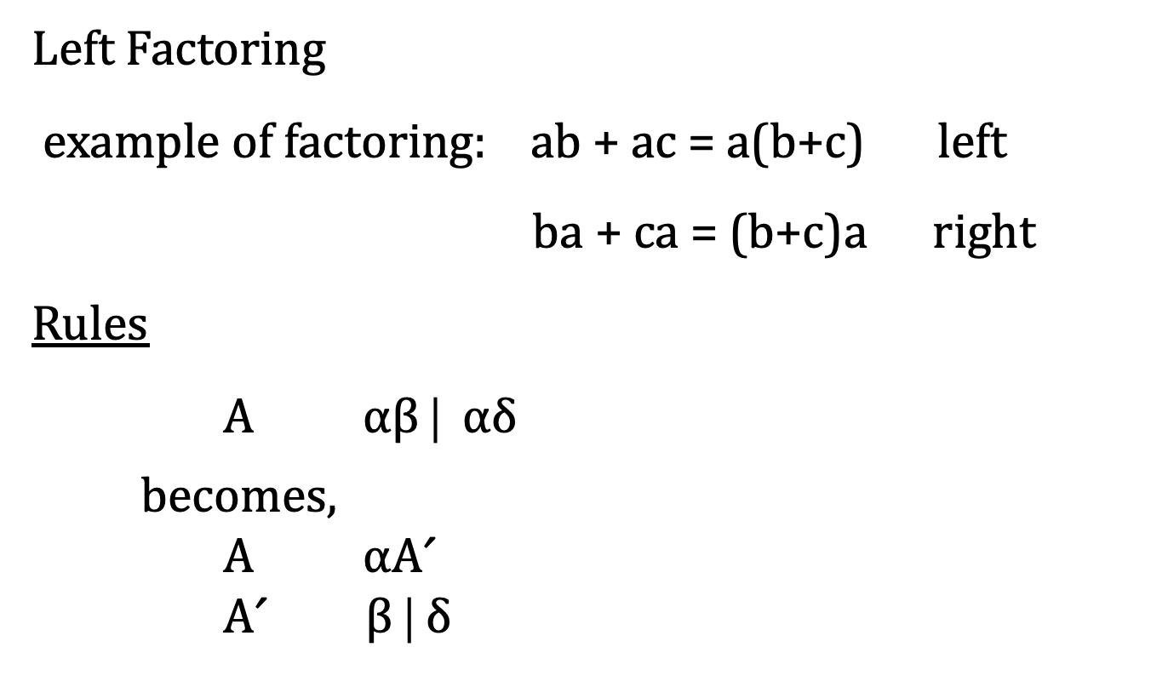
Left Factoring
example of factoring: ab + ac = a(b+c) left
ba + ca = (b+c)a right
Rules
A α$\text{β}$ | αδ
becomes,
A αAˊ
Aˊ $\text{β}$ | δ

Slide 63
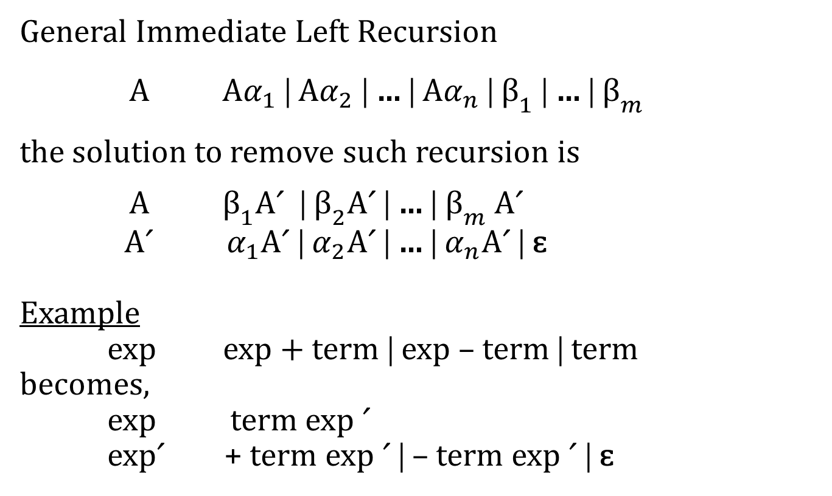
General Immediate Left Recursion
A A$α_{1}$ | A$α_{2}$ | … | A$α_{n}$ | ${\text{β}}_{1}$ | … | ${\text{β}}_{m}$
the solution to remove such recursion is
A ${\text{β}}_{1}$Aˊ | ${\text{β}}_{2}$Aˊ | … |${ \text{β}}_{m}$ Aˊ
Aˊ $α_{1}$Aˊ | $α_{2}$Aˊ | … | $α_{n}$Aˊ | ɛ
Example
exp exp + term | exp – term | term
becomes,
exp term exp ˊ
expˊ + term exp ˊ | – term exp ˊ | ɛ

Slide 64
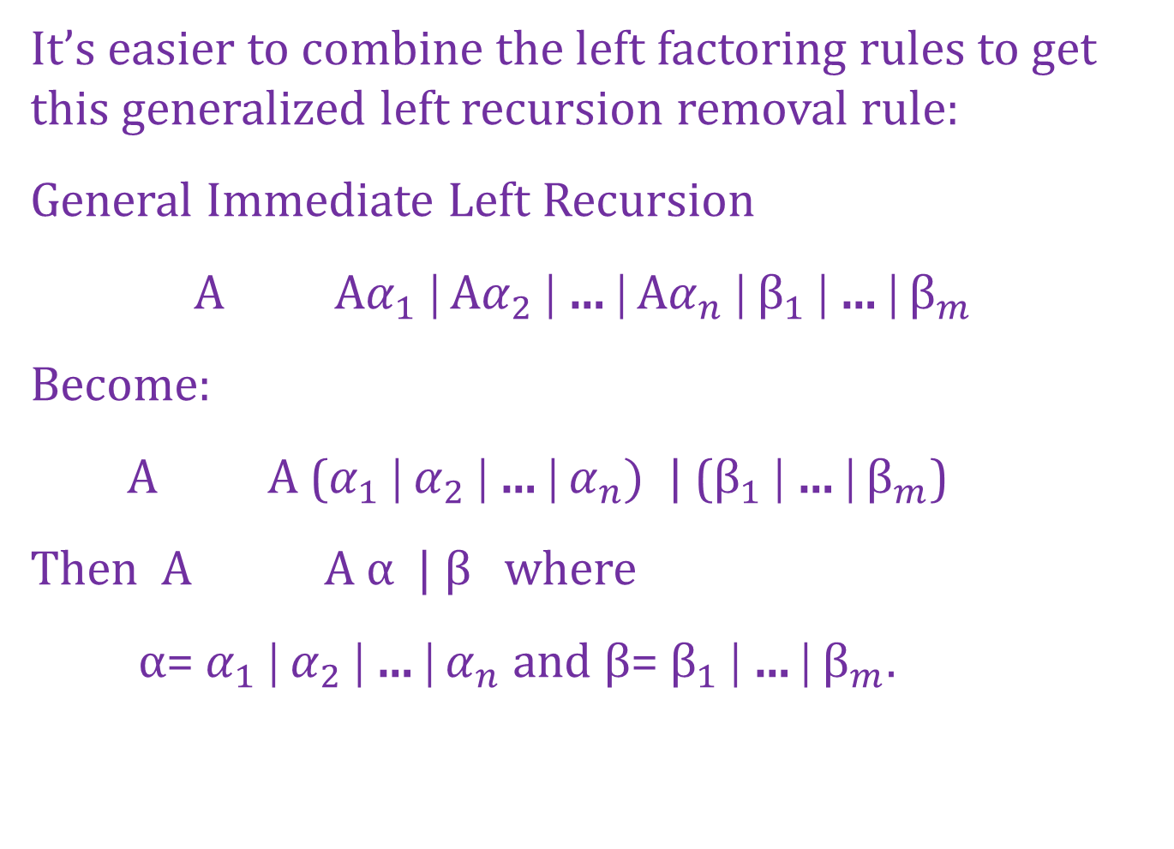
It’s easier to combine the left factoring rules to get this generalized left recursion removal rule:
General Immediate Left Recursion
A A$α_{1}$ | A$α_{2}$ | … | A$α_{n}$ | ${\text{β}}_{1}$ | … | ${\text{β}}_{m}$
Become:
A A ($α_{1}$ | $α_{2}$ | … | $α_{n})$ | (${\text{β}}_{1}$ | … | ${\text{β}}_{m}$)
Then A A α | β where
α= $α_{1}$ | $α_{2}$ | … | $α_{n}$ and β= ${\text{β}}_{1}$ | … | ${\text{β}}_{m}$.

Slide 65
A more complicate example:
A Ba | Aa | c B Bb | Ab | d
Step 1
A Aa | (Ba| c)
α=a
β=(Ba| c)
A BaAˊ | cAˊ (apply rules to A)
Aˊ aAˊ | ɛ
B Bb | Ab | d
Still left recursion: A=>BaA’=>AbaA’ for A.
*
*
* recursion introduced
*

Slide 66
A more complicate example:
Step 2
Sub A BaAˊ | cAˊ into B Bb | Ab | d
We get rid of A left recusion:
B Bb | BaAˊ b | cAˊ b | d
That is,
B B( b | aAˊ b) | (cAˊ b | d)
α= ( b | aAˊ b) , β=(cAˊ b | d)

Slide 67
A more complicate example:
A Ba | Aa | c B Bb | Ab | d
Step 3 (apply rules to B)
B B( b | aAˊ b) | (cAˊ b | d)
α= ( b | aAˊ b) , β=(cAˊ b | d)
A BaAˊ | cAˊ
Aˊ aAˊ | ɛ
B cAˊ bBˊ | dBˊ
Bˊ bBˊ | aAˊ bBˊ | ɛ
*
*
* recursion introduced

Slide 68
Chapter 5. Bottom-Up Parsing
LR(1) Parsing LR(0) Parsing
Overview of Bottom-up Parsing (shift-reduce parsing)
Shift a terminal from the front of the input to the top of the stack.
Reduce a string, α, at the top of the stack to a non-terminal A, given the BNF choice A α. When Sˊ is reached, stop.
# of tokens
lookahead
Direction to
process input
lookahead
Direction of left- or right-
most derivation

Slide 69
Example: S ( S ) S | ɛ . For the purpose of shift-reduce parsing, we rewrite it as the augmented grammar:
Sˊ S (Sˊ becomes new start symbol)
S ( S ) S | ɛ
Note: S’ will never appear on the right-hand-side of a rule. When performing the parsing, S’ can only be the root where the parsing ends.

Slide 70
Example: S ( S ) S | ɛ becomes,
Sˊ S (Sˊ becomes new start symbol)
S ( S ) S | ɛ
 | Parsing Stack | Input | Action
1 | $ | ( )$ | shift
2 | $( | )$ | reduce S ɛ
3 | $(S | )$ | shift
4 | $(S) | $ | reduce S ɛ
5 | $(S)S | $ | reduce S (S)S
6 | $S | $ | reduce Sˊ S
7 | $Sˊ | $ | ACCEPT

Slide 71
Example: Eˊ E
E E + n | n
Parsing action for the string n+n.
 | Parsing Stack | Input | Action
1 | $ | n+n$ | shift
2 | $n | +n$ | reduce E n
3 | $E | +n$ | shift
4 | $E+ | n$ | shift
5 | $E+n | $ | reduce E E+n
6 | $E | $ | reduce Eˊ E
7 | $Eˊ | $ | ACCEPT

Slide 72
Finite Automata of LR(0) items and LR(0) Parsing
An LR(0) item of CF grammar is a production choice with a distinguished position ( . ) in its right-hand side.
Example Sˊ S
S ( S ) S | ɛ has the following LR(0) items:
*Notice that there are 8 choices from 3 distinct production rules.
Sˊ .S
Sˊ S.
S .( S ) S
S (. S ) S
S (S . ) S
S (S ) . S
S (S ) S .
S .

Slide 73
NFA with - transition for: Sˊ S , S ( S ) S | ɛ
ɛ
.S: ɛ-transitions
(1) S .(S)S
(2) S .
Sˊ .S
S
Sˊ S.
ɛ
ɛ
S .
S .(S)S
(
ɛ
ɛ
ɛ
S
S (S.)S
)
S
S (. S)S
S (S).S
S (S)S.
ɛ

Slide 74
Example:
Eˊ E
E E + n | n
* note: There are 8 LR(0) items.
Eˊ .E
Eˊ E.
E .E + n
E E. + n
E E +. n
E E + n.
E .n
E n.

Slide 75
Eˊ .E
E
Eˊ E.
ɛ
ɛ
ɛ
E .E+n
ɛ
E . n
n
E n.
E
E E.+n
Example:
Eˊ E
E E + n | n
+
E E+.n
n
E E+n.
DFA conversion for your enjoyment.

Slide 76
Example: For the given CFG: A ( A ) | a, we will show
augmented grammar; 2. LR(0) items; 3. NFA; 4. DFA;
5. Simple LR(1) Parsing or SLR(1).
Augmented Grammar:
Aˊ A
A ( A )
A a
2. LR(0) Items:
Aˊ .A A .( A ) A .a
Aˊ A. A ( .A ) A a.
A ( A .)
A ( A ).

Slide 77
ɛ
2. NFA with - transition (8 LR(0) items, 8 states):
Aˊ .A
A
Aˊ A.
ɛ
ɛ
A .(A)
A . a
a
A a.
ɛ
(
ɛ
A (.A)
A
A (A.)
)
A (A).

Slide 78
3. Construct DFA from the NFA.
Aˊ .A
Aˊ A.
A .(A)
A
A . a
1
0
a
(
A a.
A (.A)
2
A .(A)
a
(
A . a
A
3
A (A.)
)
A (A).
4
5

Slide 79
4. SLR(1) Parsing actions for given string ( ( a ) ). S=shift, R=reduce.
Parsing Stack
Input
Action
1
$0
((a))$
S3
2
$0(3
(a))$
S3
3
$0(3(3
a))$
S2
4
$0(3(3a2
))$
R: A a
5
$0(3(3A4
))$
S5
6
$0(3(3A4)5
)$
R: A (A)
7
$0(3A4
)$
S5
8
$0(3A4)5
$
R: A (A)
9
$0A1
$
R: Aˊ A
10
$0Aˊ
$
ACCEPT

Slide 80
5. SLR(1) Parsing actions for given string ( ( a ).
Parsing Stack
Input
Action
1
$0
((a)$
shift
2
$0(3
(a)$
shift
3
$0(3(3
a)$
shift
4
$0(3(3a2
)$
reduce A a
5
$0(3(3A4
)$
shift
6
$0(3(3A4)5
$
reduce A (A)
7
$0(3A4
$
Do not accept
Do not accept ((a) as a string in the language defined by
the CFG since the Parsing Stack is not 0A'.

Slide 81
6. SLR(1) Parsing actions for given string ( a ) ).
Parsing Stack
Input
Action
1
$0
(a))$
shift
2
$0(3
a))$
shift
3
$0(3a2
))$
reduce A a
4
$0(3A4
))$
shift
5
$0(3A4)5
)$
reduce A (A)
6
$0A1
)$
reduce A’ A
7
$0A’
)$
Do not accept
Do not accept (a)) as a string in the language defined by
the CFG since the Input Stack is not empty.

